Slide 1
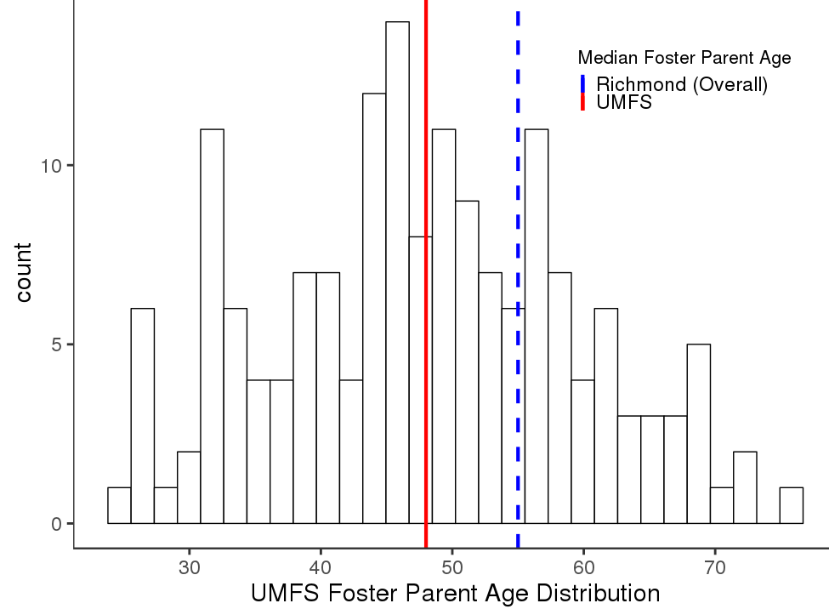
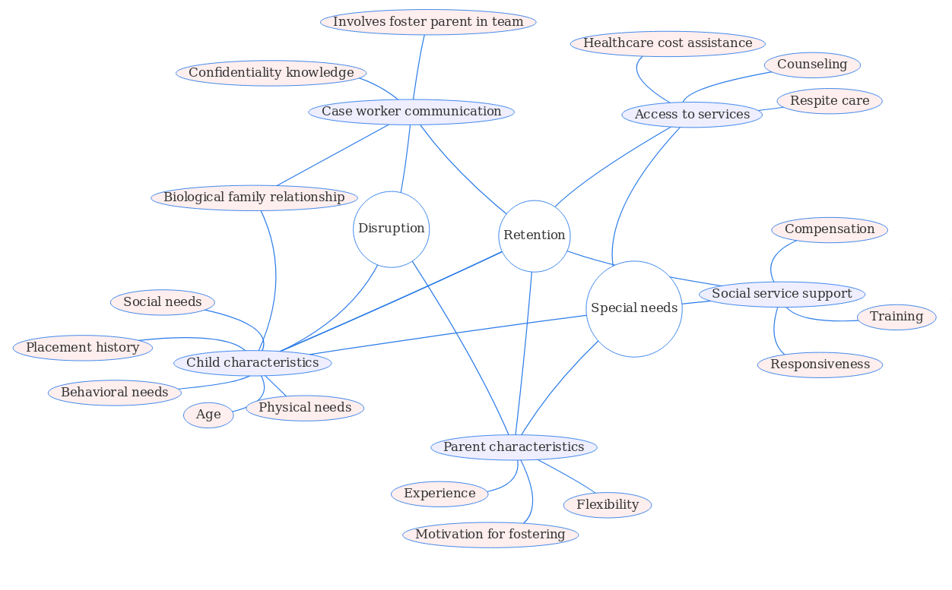


UMFS: Retention of Foster Parents for Foster Children with Special Medical or Behavioral Needs
Armi Mosavian Daniel Liden Brian Goode Josh Goldstein
Virginia Tech University of Minnesota, Twin Cities VT SDAL VT SDAL
United Methodist Foster Services
The Project: Retention and Disruptions
UMFS recruits and trains parents for treatment foster care and aims to provide stable foster homes for children and adolescents with special medical and behavioral needs.
Treatment foster care focuses specifically on children with behavioral, emotional, or social challenges; special medical needs; and histories of disruptions or trauma in the foster care system. UMFS also works to match adolescents and teens, who often struggle to find stable foster placements, with foster families.
UMFS is interested in using data from various points of contact between UMFS and foster parents in order to identify foster parent characteristics associated with placement stability and to find opportunities for training and other interventions aimed at improving foster parent retention. Improving retention means ensuring that current foster parents keep fostering in the future. Improving placement stability means ensuring that foster children are able to remain in the same home for a long period of time. Disruption occurs when a foster child needs to be removed from his/her current living situation.
We first compared the demographics of UMFS’s foster families in Richmond, VA to the broader foster family population in Richmond. We obtained the overall Richmond foster data from the The Adoption and Foster Care Analysis and Reporting System (AFCARS) dataset, which comes from a federally-mandated data collection process providing case-level demographic data on children in adoption/foster care programs.
Literature Review
Figure 1: The median age of UMFS foster parents was lower than that of the foster parent population of Richmond as a whole. We also found that a higher proportion of UMFS foster parents were white compared to the overall Richmond foster parent population.
(“Adoption and Foster Care Analysis and Reporting System (AFCARS) Data File.” 2017. US Department of Health and Human Services Administration for Children and Families. Accessed through National Data Archive on Child Abuse and Neglect)
Literature Review
Gibbs, Deborah. 2005. “Understanding Foster Parenting: Using Administrative Data to Explore Retention.” Washington, D.C.: U.S. Department of Health and Human Services, Office of the Assistant Secretary for Planning and Evaluation.
“Guide to Supporting Foster Parents.” 2013. Module 3. Wisconsin Foster Parent Retention & Support Subcommittee.
Orme, John G., and Donna J. Cherry. 2015. “The Vital Few Foster Parents: Replication and Extension.” Children and Youth Services Review 56 (September): 33–41.
Orme, John G., Donna J. Cherry, and Taylor E. Krcek. 2013. “Who Is Willing to Foster Children With Disabilities?” Journal of Public Child Welfare 7 (5): 566–85.
“Recruitment and Retention of Resource Families.” 2005. 001. Breakthrough Series Collaborative. Seattle, WA: Casey family programs. Rhodes, Kathryn W., John G. Orme, and Cheryl Buehler. 2001. “A Comparison of Family Foster Parents Who Quit, Consider Quitting, and Plan to Continue Fostering.” Social Service Review 75 (1): 84–114.
Literature Review
Lightfoot, Elizabeth. 2014. “Children and Youth with Disabilities in the Child Welfare System: An Overview.” Child Welfare 93 (2): 23–45.
Orme, John, Donna J. Cherry, and Mary Ellen Cox. 2013. “Measuring Willingness to Foster Children with Disabilities and Special Medical Conditions.” Social Work Research 37 (3): 169–78.
Orme, John G., and Donna J. Cherry. 2015. “The Vital Few Foster Parents: Replication and Extension.” Children and Youth Services Review 56 (September): 33–41.
Orme, John G., Donna J. Cherry, and Jason D. Brown. 2017. “Against All Odds: Vital Few Foster Families.” Children and Youth Services Review 79 (August): 584–93.
Orme, John G., Donna J. Cherry, and Taylor E. Krcek. 2013. “Who Is Willing to Foster Children With Disabilities?” Journal of Public Child Welfare 7 (5): 566–85.
Numerous analyses of surveys and administrative data from foster parents have been published in the past. Much of the published research focused on the core themes of this project: foster parent retention, prevention of disruptions, and unique features of providing foster care for adolescents and teens with special needs. We reviewed the existing literature to extract data-supported themes and recommendations.
Practice Implications
Building a strong and open relationship between case workers can help to ensure that foster parents receive the ongoing support they need.
Training should include a focus on predictable life changes and how to manage them while providing foster care. Parents who feel supported are more likely to continue fostering.
The “vital few” foster parents who foster the most children for the greatest periods of time can are important resources. Their experiences can be useful to both less-experience foster parents and decision makers in child welfare agencies.
Foster parent should be involved in, or at least made aware of, decisions regarding their foster children’s futures.
Key Findings
The willingness of parents to foster a child with special needs changes depending on the child’s specific needs.
  Willingness to foster special needs children also depends on the resources, help, and support provided to the foster family.
Foster parents noted that they would be more willing to foster special needs childten if they were able to get pre/post licensure and training that addresses special needs.
Approximately 20% of foster parents provide 60-80% of foster care. These parents tend to foster longer, foster more children, and foster children with a greater variety of needs.
  Foster mothers can be broken down into unconditional and selective mothers; the former willing to foster any child, and the latter having specific requirements
Concept Map
[1] “Recruitment and Retention of Resource Families.” 2005. 001. Breakthrough Series Collaborative. Seattle, WA: Casey family programs.
[2] Orme, John G., and Donna J. Cherry. 2015. “The Vital Few Foster Parents: Replication and Extension.” Children and Youth Services Review 56 (September): 33–41.
[3] Orme, John, Donna J. Cherry, and Mary Ellen Cox. 2013. “Measuring Willingness to Foster Children with Disabilities and Special Medical Conditions.” Social Work Research 37 (3): 169–78.
[4] Rhodes, Kathryn W., John G. Orme, and Cheryl Buehler. 2001. “A Comparison of Family Foster Parents Who Quit, Consider Quitting, and Plan to Continue Fostering.” Social Service Review 75 (1): 84–114.
[5] Semanchin Jones, Annette, and Susan Wells. 2008. “PATH/Wisconsin - Bremer Project: Preventing Placement Disruptions in Foster Care.” Literature Review. University of Minnesota School of Social Work.
[6] “Guide to Supporting Foster Parents.” 2013. Module 3. Wisconsin Foster Parent Retention & Support Subcommittee.
Key Findings
Major factors linked to foster parent attrition include dissatisfaction with the child welfare agency, poor communication with case workers, inability to handle foster child behavior, and lack of access to specific services.
Major changes in foster parents’ lives, such as illness and divorce, are a major reason for foster parents quitting.
Foster parents report insufficient training in areas including fostering children from different races/cultures, fostering children with special needs, and fostering teenagers.
Practice Implications
Providing training for potential and current foster parents on how to take care of children with special needs could increase the willingness of parents to foster children with special needs.
Adequate compensation and support should be given to parents who are fostering special needs children to ease financial and emotional burdens that could arise from medical costs.
Parents should be fully informed on the extent of special needs a child has so as to be adequately prepared to take on the child.
Stigmas have been and should continue to be destroyed around certain special needs so as to lessen the hesitancy on fostering children with those needs.
[1]
Further Steps
[1]
[4]
[4]
[6]
The the literature search identified major themes associated with foster parent retention, particularly in the context of special needs foster care. These major themes are highlighted in the concept map.
Further data from UMFS, particularly home studies, can be analyzed with respect to the themes identified in this literature review. For instance, the literature suggests that relationships with case workers are important for foster parent success and retention. Any information related to relationships with case workers can be extracted from the home studies and analyzed.
Further data discovery and/or collection, perhaps in the form of surveys addressing the themes identified in the literature, could be used to generate new evidence specific to UMFS’s foster parent population.
[5]
[3]
[4]
[5]
[2]
Stay Connected:
facebook.com/biocomplexity
twitter.com/biocomplexityvt
youtube.com/c/biocomplexity
google.com/+biocomplexity
Notes:
GENERAL RULES TO FOLLOW:
Stay in Google Slides to work on your poster because it:
provides a template with all the approved branding including colors, fonts, and logo placement/usage;
allows you to collaborate with others;
helps you to communicate with your fellow researchers, lab./dept., and creative services;
Editing this file:

